Slide 1
6-2. Principal Component Analysis (PCA)
Youngsoo Kim <pineland@hanmail.net>
Code : https://github.com/pineland/AIDA/

Slide 2
Contents
Why dimensionality reduction ?
What is PCA ?
Computing the components
PCs, Variance and eigenvectors
Steps for PCA
How many dimensions should be reduced?
Limitations of PCA

Slide 3
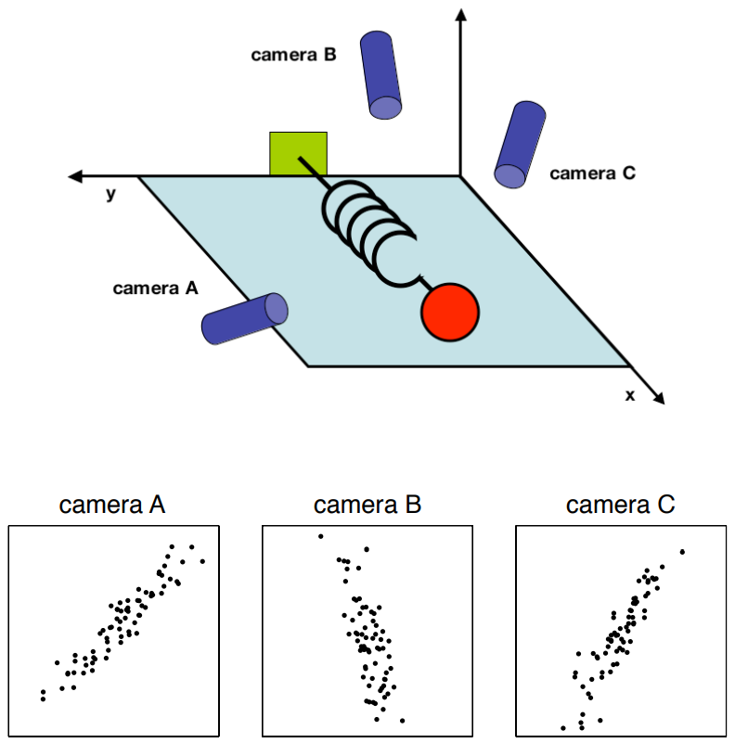

Slide 4
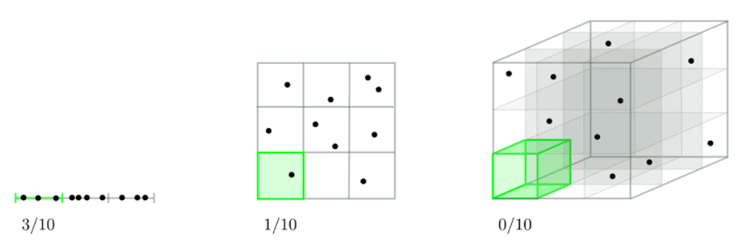
Why dimensionality reduction ?
Preserve useful information in a low memory.
Less time complexity
Less space complexity
Visualization
Reduce noise

Slide 5
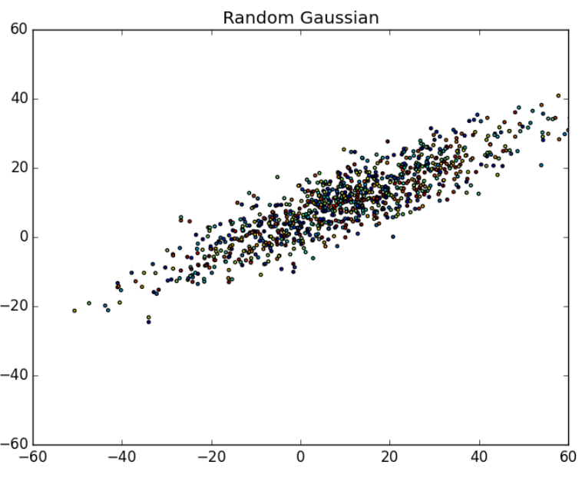
How to reduce dimensions ?

Slide 6
What is PCA ?
A technique to reduce the dimensionality by linearly combining correlated variables.
Reduces dimensions while preserving the structure of the data.
NOT change the order of data values, distribution shape of data, etc.
Principle
Linear projection method to reduce the number of parameters
Transfer a set of correlated variables into a new set of uncorrelated variables
Map the data into a space of lower dimensionality
Form of unsupervised learning

Slide 7
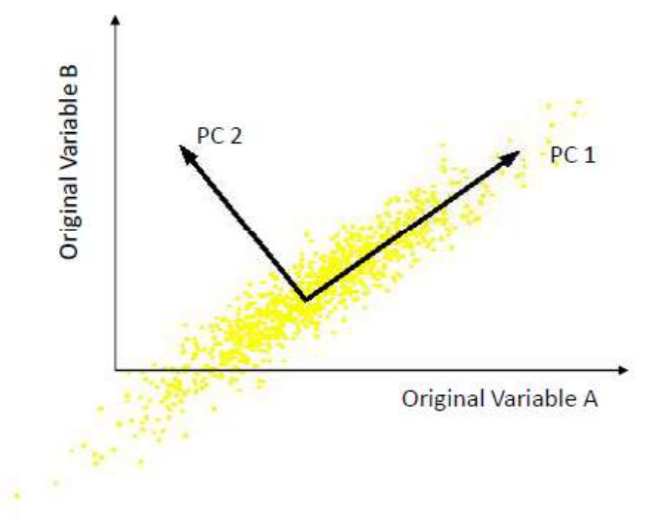
How to reduce dimensions -Preliminary
What are the new axes?

Slide 8
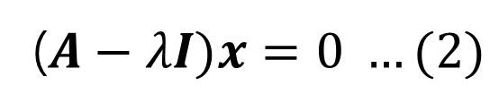

Computing the components
Definition of eigenvector & eigenvalue
For any n×n matrix A, if non-zero solution vector x exists in the following linear systems, the number λ is said to be eigenvalue and x to be eigenvector for the matrix A.
The eq. (1) can be changed by the nature of the matrix as follows:
The required sufficiency condition for vector x to have non-trivial solution is set (A-λI)=0.
$$Ax= λx …(1)$$
($A−λI)x=0 …(2)$

Slide 9
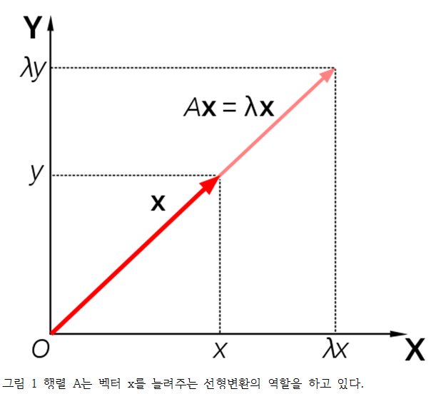

Computing the components
Meaning of eigenvalues and eigenvectors
Let's think about the geometric meaning from eq. (1). For any non-zero vector x, this is a case of λ times the size.
“어떠한 선형변환 A를 했을 때, 그 크기만 변하고 방향이 변하지 않는 벡터(축)가 있나요?”
“그렇다면, 그 벡터의 크기는 얼마만큼 변했나요?”
A에 대한 eigenvalue와 eigenvector가 존재한다면, 2차원의 A matrix를 1차원 λ(scalar)으로 차원을 줄일 수 있다는 것이다.

Slide 10
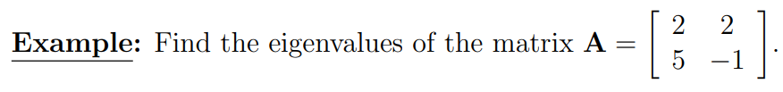
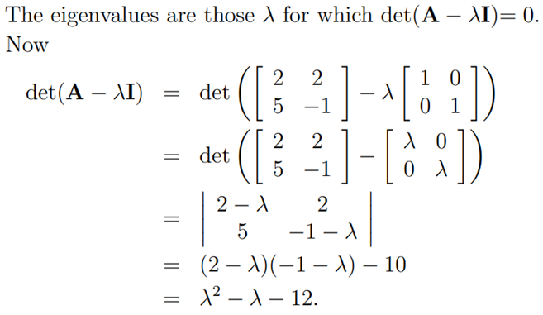
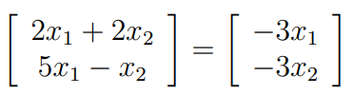
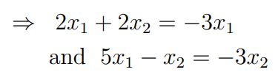











Calculation of eigenvalue and eigenvector
$Let substitute λ= -3 in eq.$(1)
$$∴$$
$$∴$$
$Similary, substitute λ=4 in eq.$(1)
$$∴$$

Slide 11
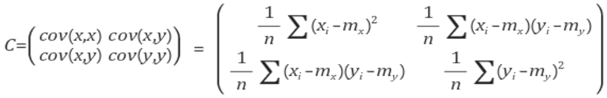
Covariance matrix
“How similar are the changes in each feature to the other features?”
If n two-dimensional data are as follows (x₁, y₁), (x₂, y2),
... and (x_{n}, y_{n}), then the covariance matrix of these data
is calculated as follows:
If the eigenvalues and the eigenvector for the covariance matrix are obtained,
Eigenvector indicates which direction(axis) the data are distributed.
Eigenvalue becomes the covariance value for each axis.
Eigenvectors having larger eigenvalues become the
principal components.
Notes:
공분산은 아주 유용합니다. 고차원 변수의 경우 시각화하기 어렵기 때문에 변수의 상관 관계를 파악하기 어렵습니다. 이럴 때 공분산을 이용하면 각 변수의 값과 부호(음/양)를 통해 변수의 관계를 쉽게 알 수 있습니다. (상관계수(Correlation coefficient)공분산을 -1과 1 사이의 값으로 정규화한 것 입니다.)[출처] [공유] 고유 벡터(Eigenvectors), PCA, 공분산(Covariance) 및 엔트로피(Entropy)에 대한 기초 강의|작성자 낙수

Slide 12
PCs, Variance and eigenvectors
First principal component is the direction of greatest variability (covariance) in the data
Second is the next orthogonal (uncorrelated) direction of greatest variability
All eigenvectors are orthogonal to each other, and N-dimensional data have N eigenvectors (eigenvalues).
The kth largest eigenvalue
of the covariance matrix is
the variance in the sample
along the kth PC.

Slide 13
Steps for PCA
Scale the data.
Calculate the covariance matrix.
Find the eigenvalues and eigenvectors of the covariance matrix.
Project the scaled data over the principal components.

Slide 14
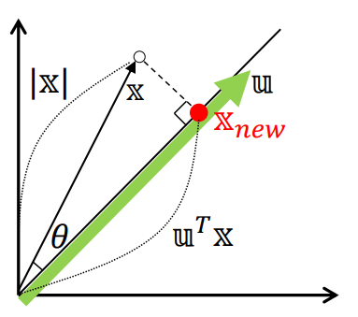
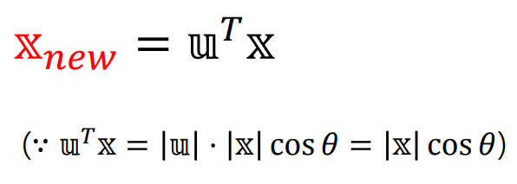
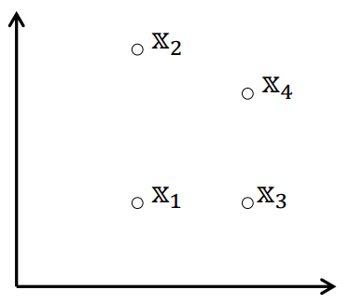
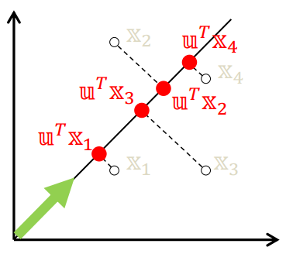

What values do the data have at the projected level?

Slide 15

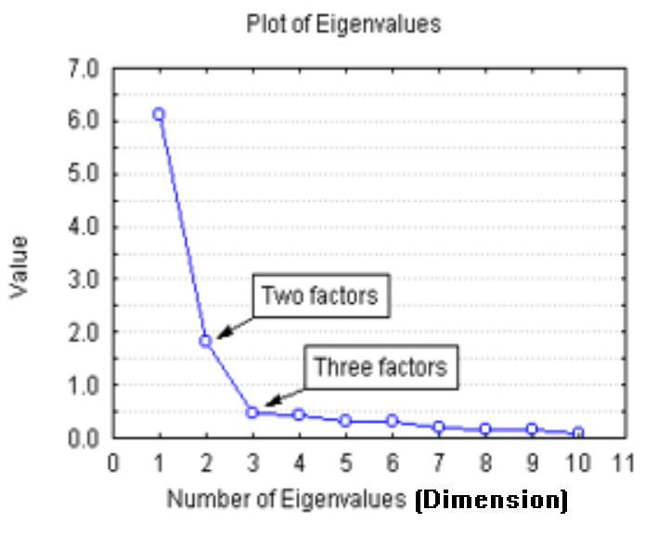
How many dimensions should be reduced?
Reduce dimensions that have more than a specific variance value, for instance, by 90%.
Using screen plots
☜ Reduce appropriate
m dimensions.

Slide 16
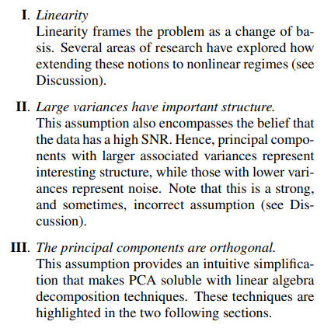
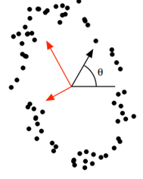
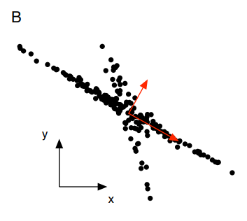
Limitations of PCA
* source : Jonathon Shlens, A Tutorial on Principal Component Analysis, Google Research (2014)
Notes:
Youtube. Terry TaeWoong Um, PCA의 이해(2)

Slide 17

Q & A

